Slide 1
MidTermTest
Example of Mid term test

Slide 2
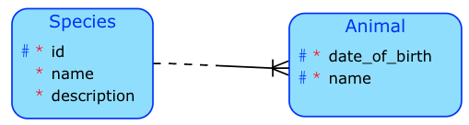
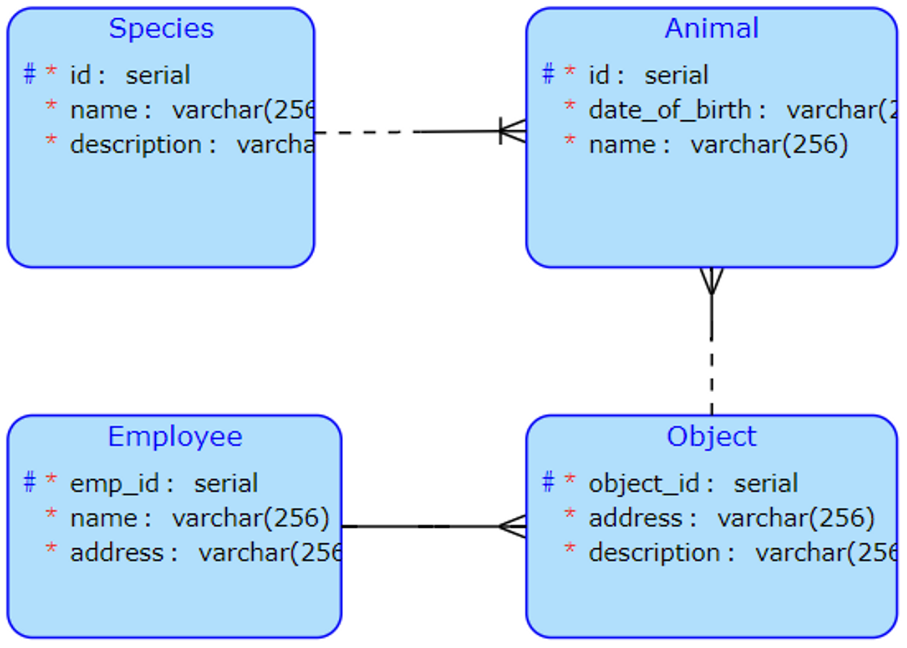
ER model - 6 points
Create conceptual model for ZOO according to following description:
There are animal species in zoo database. Let us provide an ID to identify individual animal species. We register name of animal species (like elephant, tiger, giraffe, etc.) and a description. We want to register also such animal species whose exemplars are not in the zoo.
Animal in the zoo has ID, but this ID is unique only in his animal species (there may be elephant 1, elephant 2, camel 1 etc.). We register name and date of birth for each animal. Each animal belongs to exactly one animal species.
There are objects identified by object id. We register address and description for each object.
Animals are located in objects. Each animal lives exactly in one object. There may be more animals in one object. We register empty objects as well.
An employees take care about whole object. Each object has exactly one responsible employee. Employee takes care about at least object.
We register name and address for each employee. Let us provide a special ID to identify individual employees.
Here exists more solutions

Slide 3
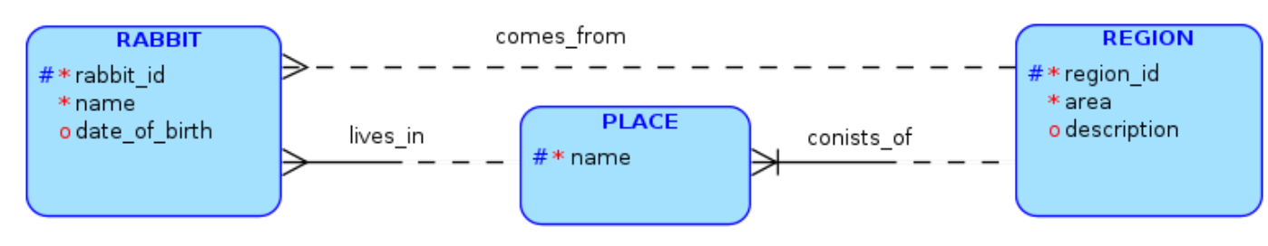
Transformation of ER schema into relational - 4 points
Transform the conceptual schema in following figure into relational. Use either symbolic (RA-like, see following test page) or SQL notation. Do not forget to provide foreign keys!
Region(region_id,area,description)
Place(name,place_region_id)
Place[place_region_id]⊆Region[region_id]
Rabbit(rabbit_id,name,date_of_birth,name,place_region_id,region_id)
Rabbit[region_id]⊆ Region[region_id]
Rabbit[name,place_region_id] ⊆ Place[name,place_region_id]

Slide 4
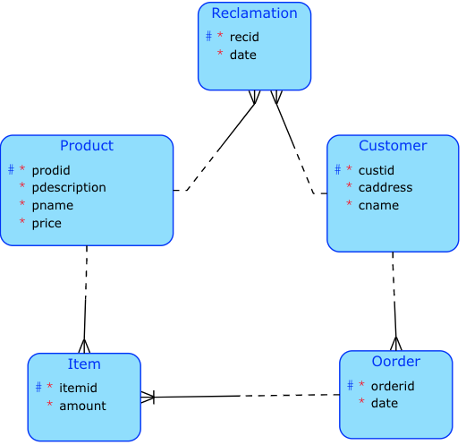
Relational Algebra - date model
Let us have a database. Primary keys are underlined, foreign keys are described using RA:
PRODUCT (PRODID, PNAME, PDESCRIPTION, PRICE)
CUSTOMER (CUSTID, CNAME, CADDRESS)
ORDER (ORDERID, CUSTID, DATE)
ITEM (ORDERID, ITEMID, PRODID, AMOUNT)
RECLAMATION(RECID, PRODID, CUSTOMER ID, PRODID, DATE)
ORDER[CUSTID] ⊆ CUSTOMER[CUSTID]
ITEM[ORDERID] ⊆ ORDER[ORDERID]
ITEM[PRODID] ⊆ PRODUCT[PRODID]
RECLAMATION[CUSTOMER ID] ⊆ CUSTOMER[CUSTID] !!! Careful !!! Keys have different names!
RECLAMATION[PRODID] ⊆ PRODUCT[PRODID]

Slide 5
Relational algebra expressions
CUSTID of customers who did their order at 21-DEC-201.
Order(Date=’21-dec-2011’)[CUSTID]
Names and prices of products ordered by customer named ’John’.
{{Customer * Order * Items * Product}(Cname=’John’)}[Pname, Price]
Products (all attributes) which had not been ordered yet.
Product !<* Item …. this is the variant with left anti-join
Product \ {Product<* Item} … this is the variant with differences
Names of customers who applied any reclamation.
Customer <* Reclamation[Customer_ID -> Custid] … variant with renaming
CUSTID of customers who ordered each product.
{{Product * Item * Order}[Custid,Prodid]} : Product[Prodid]... variant with database division

